Slide 1
Data Science
Dr. Kashif Zafar
Lecture No 10
Machine Learning
Classification
Artificial Neural Networks
Department of Computer Science
National University of Computers & Emerging Sciences
Lahore.

Slide 2
Machine Learning
Machine learning (ML) is a subset of AI that enables systems to learn from data, identify patterns, and improve performance over time without explicit programming.
It uses algorithms to analyze large datasets—including supervised, unsupervised, and reinforcement methods—to make predictions or generate content, powering technologies like recommender systems, fraud detection, and self-driving cars.

Slide 3
Classification
Classification is the systematic process of organizing objects, data, or organisms into groups (classes) based on shared characteristics, rules, or criteria.
It facilitates easier identification, understanding, and analysis by placing items into distinct categories, such as in subjects, libraries, or labels.
A supervised learning technique that constructs models (e.g., Decision Trees, Neural Networks, SVM) to predict the class label of new, unseen data.
Supervised and Unsupervised Classification or Learning.

Slide 4
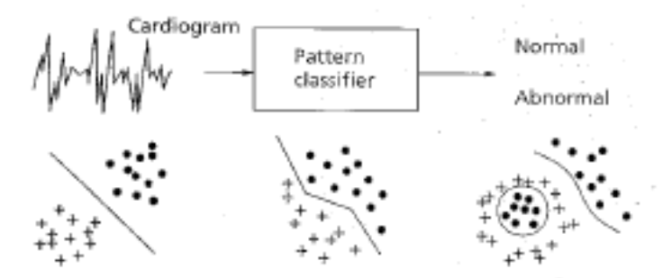
ARTIFICIAL NEURAL NETWORKS
Types of Problems which can
be solved by ANN
Pattern Classification
The task of pattern classification is to assign an input pattern (represented by a feature vector) to one of many pre -specified classes
Applications include speech recognition (speech waveforms), character recognition (handwritten symbol), EEG waveform classification, blood cell classification
Notes:
Electroencephalography (EEG) is the recording of electrical activity along the scalp.

Slide 5
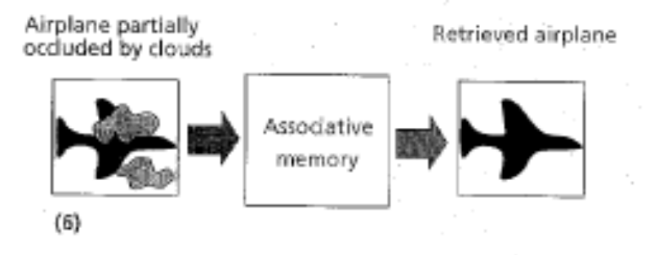
ARTIFICIAL NEURAL NETWORKS
Pattern Completion
To complete the missing parts of a given input vector
The NN acts as an associative memory, whose contents can be recalled even by a partial input or distorted content.

Slide 6
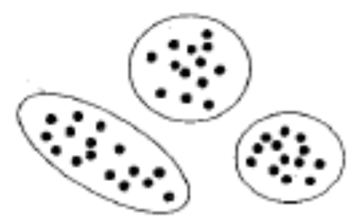
ARTIFICIAL NEURAL NETWORKS
Clustering
In clustering, the training data is unsupervised (class labels are not available)
The similarity between patterns is explored and similar patterns are grouped together, thus forming clusters

Slide 7

ARTIFICIAL NEURAL NETWORKS
Optimization
To find the optimal values of parameters. A wide variety of problems can be posed as optimization problems
The goal of an optimization algorithm is to find a solution satisfying a set of constraints such that an objective function is maximized or minimized (example TSP)
Some NN architectures & their training algorithms can be used to solve optimization problems

Slide 8

ARTIFICIAL NEURAL NETWORKS
Prediction / Forecasting
Given a set of n samples in a time sequence, the task is to predict the sample n + 1
Stock market prediction and weather forecasting are typical applications of prediction techniques

Slide 9
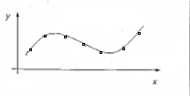
ARTIFICIAL NEURAL NETWORKS
Function Approximation/Time Series Modeling
To learn the functional relationships between input and desired output vectors
Suppose a set of labeled training patterns (input-output pairs) have been generated from an unknown function (may be subject to noise). The task of FA is to find an estimate of the unknown function. Various engineering and scientific modeling problems require FA

Slide 10
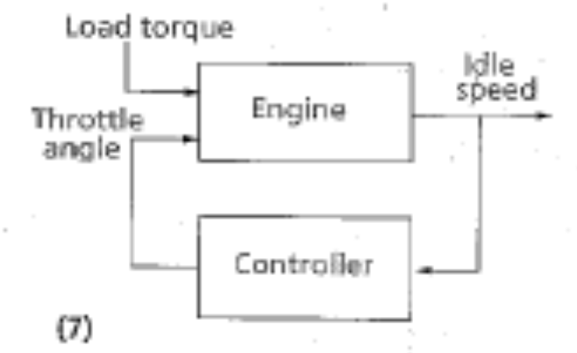
ARTIFICIAL NEURAL NETWORKS
Control
An appropriate action is suggested, given an input vector
Consider a dynamic system defined by a tuple {u(t), y(t)}, where u(t) is the input from the controller and y(t) is the resulting output of the system at time t. The goal is to generate a control input u(t) such that the system follows a desired trajectory.

Slide 11
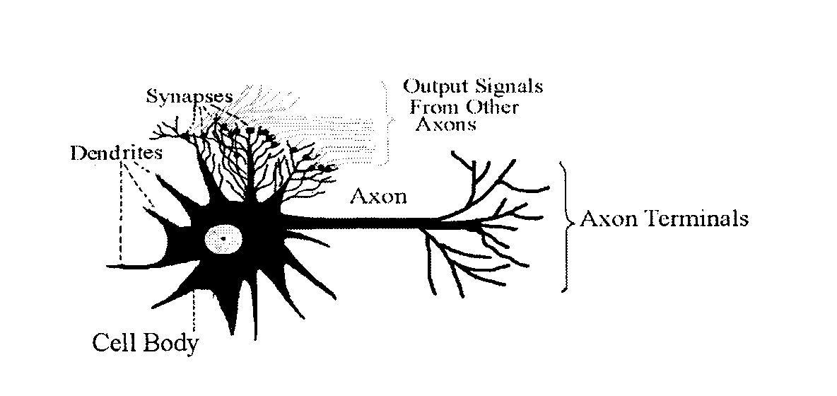
NEURAL NETWORKS
Biological Neuron
About 100 billion neuron in the human brain

Slide 12
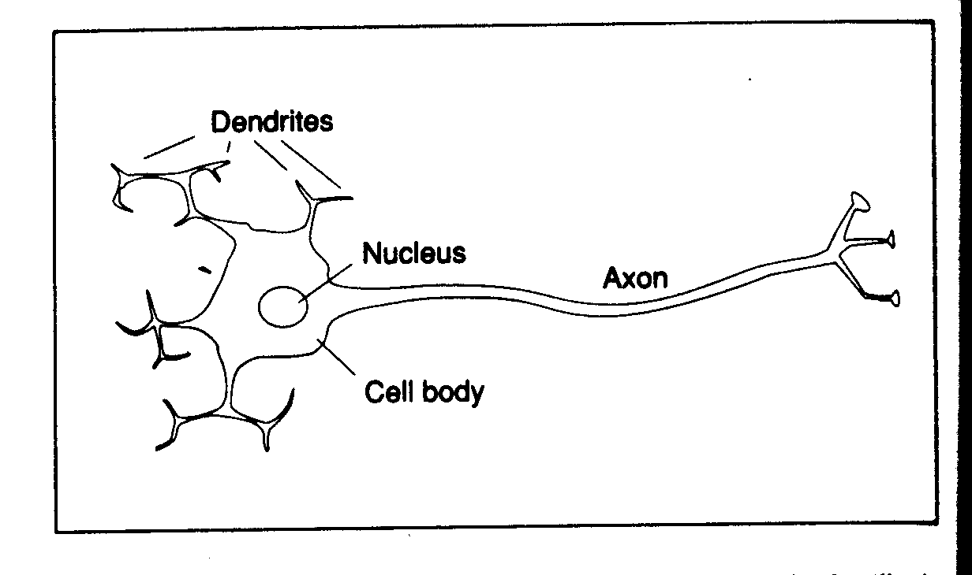
NEURAL NETWORKS
Biological Neuron

Slide 13
NEURAL NETWORKS
Biological Neuron
The main body of the cell collects the incoming signals from the other neurons through its dendrites
The incoming signals are constantly being summed in the cell body
If the result of the summation crosses as certain threshold, the cell body emits a signal of its own (called firing of the neuron)
This signal passes through the neuron’s axon, from where the dendrites of other neurons pick it up

Slide 14
NEURAL NETWORKS
Biological Neuron
There are 1,000 to 10,000 dendrites in each neuron (few millimeters long)
There is only one axon (several centimeters long)
The connection between dendrites and axon is electrochemical and it is called synapses
The synapses modify the signal while passing it on to dendrites
The human learning is stored in these synapses, and the connection of neurons with other neurons

Slide 15
NEURAL NETWORKS
Biological Neuron
The human learning is stored in these synapses, and the connection of neurons with other neurons
If stimulus at a dendrite causes the neuron to fire, then the connection between that dendrite and axon is strengthened
If the arrival of stimulus does not cause the neuron to fire, the connection weakens over time

Slide 16
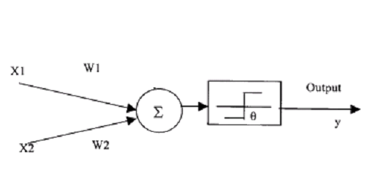
NEURAL NETWORKS
Artificial Neuron Model

Slide 17
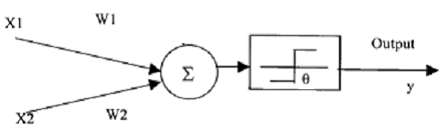
NEURAL NETWORKS
Artificial Neuron Model
Implementation of AND
function
Let W₁ = W₂ = 1
X₁ X₂ X₁W₁ + X₂W₂ Y
0 0 0 0
0 1 1 0
1 0 1 0
1 2 1
If we make θ = 2 (or any value >1 but <=2), we will get correct results with a unit step activation function

Slide 18
NEURAL NETWORKS
Artificial Neuron Model
If we place the 4 points in a two coordinate system (X1 and X2), we have drawn a line from (2, 0) to (0, 2) in the resulting plane
Any new data falling on the left side of the line will give an output of zero and the data on the right side of the line will be classified as one

Slide 19
NEURAL NETWORKS
Artificial Neuron Model
Implementation of OR
function
Let W₁ = W₂ = 1
X₁ X₂ X₁W₁ + X₂W₂ Y
0 0 0 0
0 1 1 1
1 0 1 1
1 2 1
If we make θ = 1 (or any value >0 but <=1), we will get correct results with a unit step activation function

Slide 20
NEURAL NETWORKS
Artificial Neuron Model
If we place the 4 points in a two coordinate system (X1 and X2), we have drawn a line from (1, 0) to (0, 1) in the resulting plane
Any new data falling on the left side of the line will give an output of zero and the data on the right side of the line will be classified as one

Slide 21
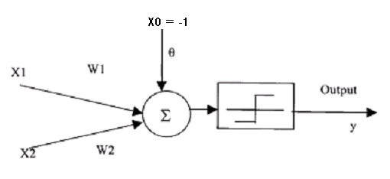
NEURAL NETWORKS
Artificial Neuron Model
If we want to utilize a unit step function centered at zero for both AND and OR neurons, we can incorporate another input X0 constantly set at –1
The weight W0 corresponding to this input would be the θ, calculated previously

Slide 22
NEURAL NETWORKS
Setting of weights (Training)
X₁ X₂ Y
1.0 1.0 1
9.4 6.4 -1
2.5 2.1 1
8.0 7.7 -1
0.5 2.2 1
7.9 8.4 -1
7.0 7.0 -1
2.8 0.8 1
1.2 3.0 1
7.8 6.1 -1

Slide 23
Class Activity
Show the mathematical working of Artificial Neural Network by taking the case in figure below. First two columns are the input values for X1 and X2 and the third column is the desired output.
Learning rate = 0.2
Threshold = 0.5
Actual output = W1X1+W2X2
Next weight adjustment = Wn+ΔWn
Change in weight = ΔWn = learning rate * (desired output- actual output) * Xn
In Figure. First two columns are input vectors x1 and x2 and last column is the desired output y.
Show the complete iterations for acquiring the desired output?
x1 x2 w1 w2 d y Δ w1 Δ w2
0 | 0 | 0
0 | 1 | 0
1 | 0 | 1
1 | 1 | 1

Slide 24
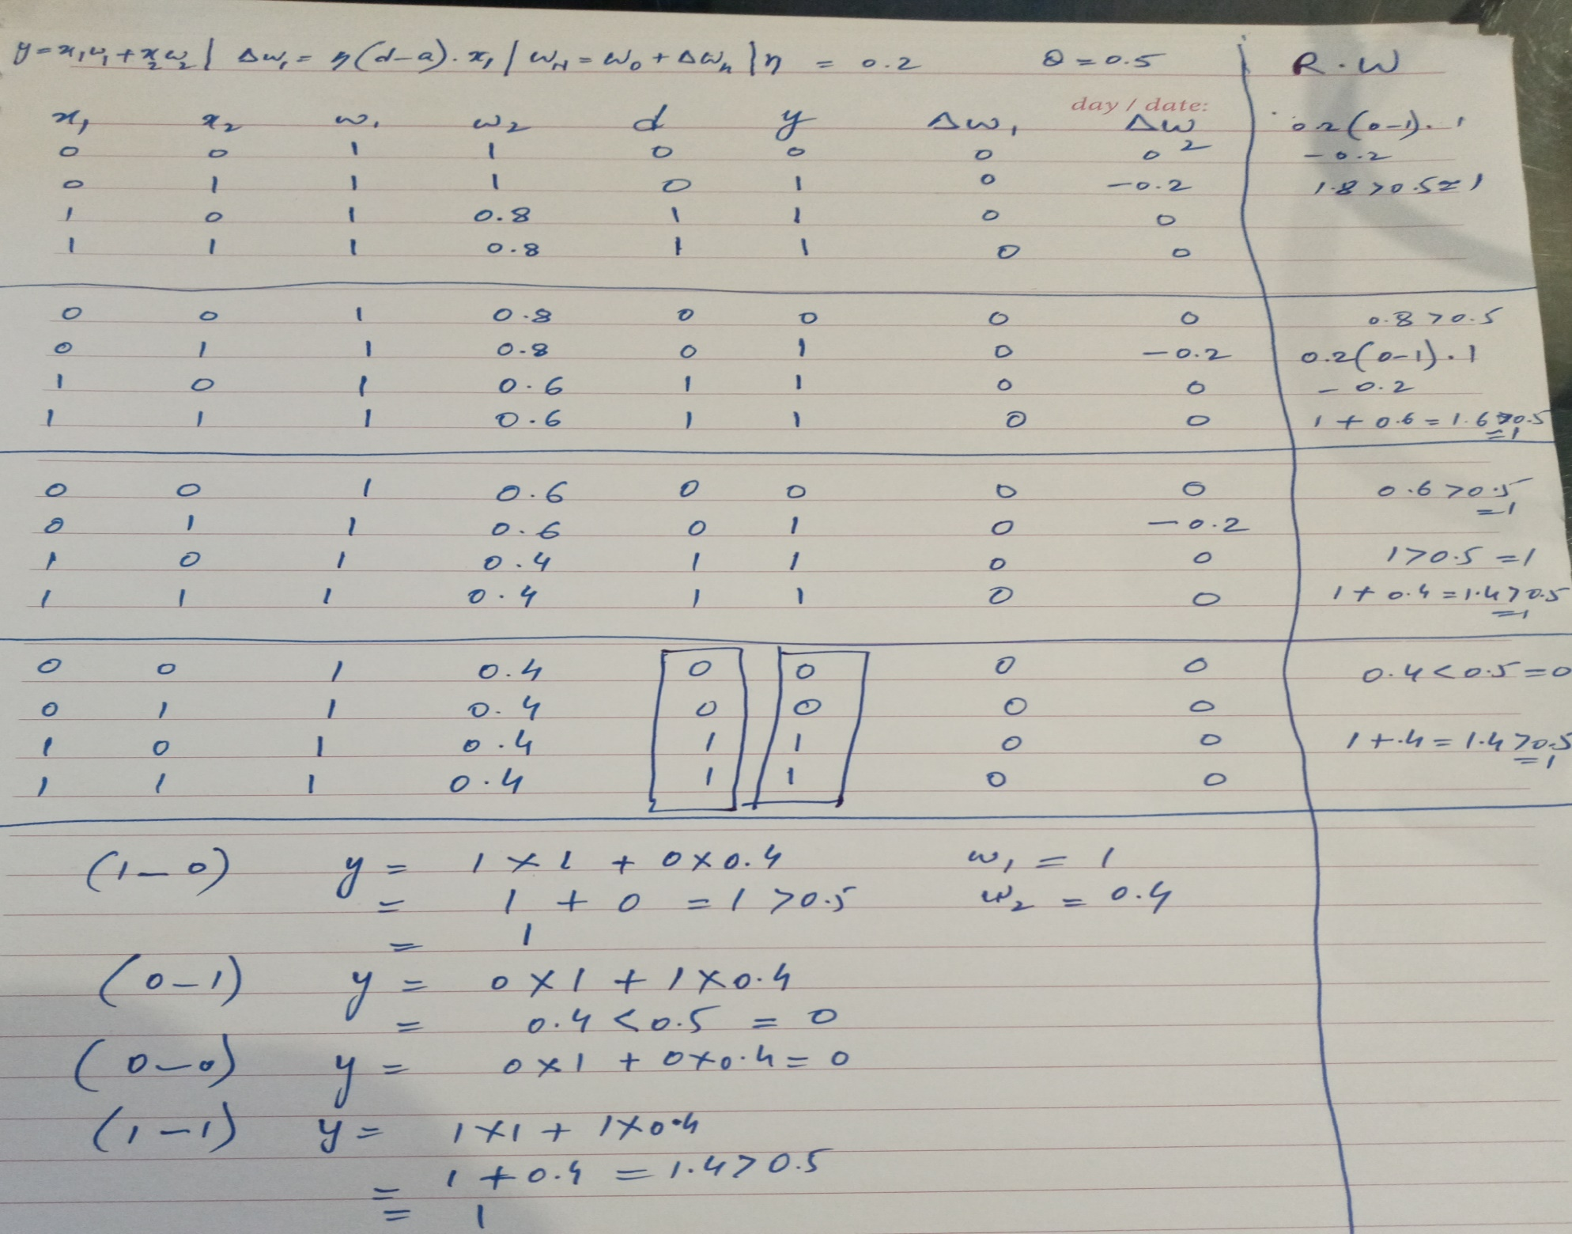

Slide 25
NEURAL NETWORKS
Training of weights
Supervised training: the classes of training samples are known
Random initialization of weights
(threshold or bias is considered as a weight and its input is fixed at 1)

Slide 26
NEURAL NETWORKS
Training of weights: Algorithm
For each input, calculate the output with the current weights
The error will be equal to y_{desired} – f(∑x_{i}w_{i})
How to reduce this error?
Input is fixed
We have to change weights
Which weight to change?
Since we don’t know which weight is contributing how much to the error, hence we change all weights

Slide 27
NEURAL NETWORKS
Training of weights: Algorithm
How much will be the change in a weight?
The change in each connection weight has to be proportional to the error and the magnitude of its input
(we assume that each weight is contributing to the error a value proportional to its input)
Change each weight by δ w_{i} = η(y – f(∑x_{i}w_{i}))x_{i}
The learning rate η is fixed at a small value, so that we may not only learn the current data sample, but also the retain the previous learning

Slide 28
NEURAL NETWORKS
Training of weights: Algorithm
Iterate repeatedly over the whole data set.
Stop when the combined error of all the inputs is below a certain threshold

Slide 29
NEURAL NETWORKS
Training of weights
For our example let [0.75, 0.5, –0.6] be the initial weights (set randomly)
Let the learning rate be 0.2
The first data sample is classified correctly
The second data sample gives an error of –2 and the weight vector should be updated
W_{new} = W_{old} + 0.2 * Error * X
= -3.01
-2.06
-1.00

Slide 30
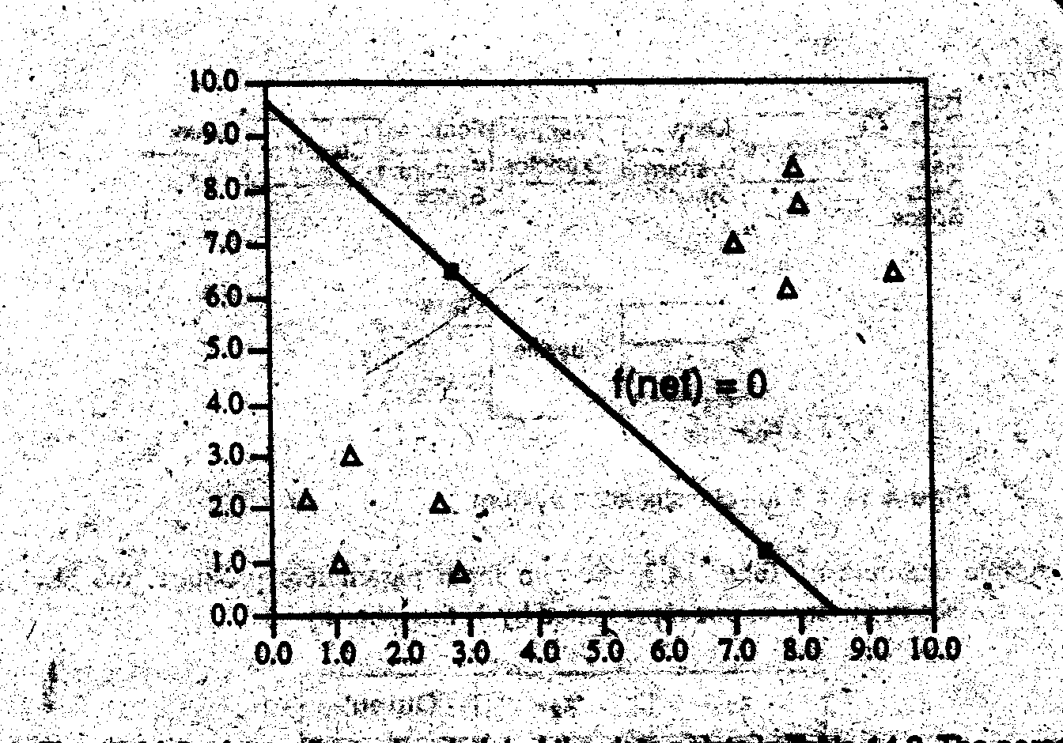
NEURAL NETWORKS
Training of weights
After 500 iterations the weights converge to [-1.3, -1.1, 10.9]
i.e. output = f(∑xiwi) = f(1.3x1 –1.1x2 + 10.9)
To draw the boundary line we take the output as zero on the boundary
i.e.
1.3x₁ – 1.1x₂ + 10.9 = 0

Slide 31
Reading Assignment & References
Section 10.1.1, 10.2.1 and 10.2.2 of Luger

Slide 32
NEURAL NETWORKS
Linearly Separable Problems
If the data can be correctly divided into two categories by a line or hyper-plane

Slide 33

NEURAL NETWORKS
Non Linear Problems
If the data cannot be correctly separated by a single line or plane, then it is not linearly separable. A single layer of neurons cannot classify the input patterns that are not linearly separable; e.g. exclusive OR problem

Slide 34
NEURAL NETWORKS
Non Linear Problems
For such problems we need two or more layers of neurons
-1
0.5
1
-1
x₁
-1
-1
1
-0.5
x₂
1
-1
-1

Slide 35
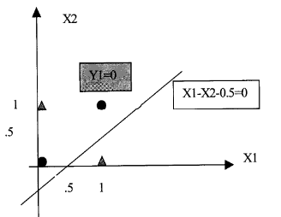
NEURAL NETWORKS
Non Linear Problems
The first neuron’s output is
Point (0, 0) => Sum = -0.5 and Y1 = 0
Point (0, 1) => Sum = -1.5 and Y1 = 0
Point (1, 0) => Sum = 0.5 and Y1 = 1
Point (1, 1) => Sum = -0.5 and Y1 = 0
It places a line

Slide 36
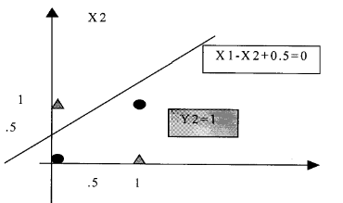
NEURAL NETWORKS
Non Linear Problems
The second neuron’s output is
Point (0, 0) => Sum = 0.5 and Y2 = 1
Point (0, 1) => Sum = -0.5 and Y2 = 0
Point (1, 0) => Sum = 1.5 and Y2 = 1
Point (1, 1) => Sum = 0.5 and Y2 = 1
It places a line

Slide 37
NEURAL NETWORKS
The input sum for the neuron of the 2nd layer = Y1 – Y2 + 1
For point (0,1) Y1 = 0, Y2 = 0, Sum = 1, Y3 = 0
For point (1,0) Y1 = 1, Y2 = 1, Sum = 1, Y3 = 0
For point (0,0) Y1 = 0, Y2 = 1, Sum = 0, Y3 = 1
For point (1,1) Y1 = 0, Y2 = 1, Sum = 0, Y3 = 1
Thus the neuron of the 2nd layer separates the data correctly

Slide 38
NEURAL NETWORKS
The first layer projects the input data (x₁, x₂) into another dimension (Y₁, Y₂)
x₂
Y₂
x₁
Y₁
In dimension (Y₁, Y₂), the data becomes linearly seperable

Slide 39
NEURAL NETWORKS
Multi Layer Perceptron: Utilization
Hence a single neuron with unit step activation function can classify the input into two categories
A
A = 0
B = 1
B

Slide 40
NEURAL NETWORKS
Multi Layer Perceptron: Utilization
Two neurons with unit step activation function can classify the input into four categories
A = 0
B = 1
00
10
A = 0
B = 1
01
11

Slide 41
NEURAL NETWORKS
Multi Layer Perceptron: Utilization
Two layers of neurons can classify complex types of inputs
B
A
A

Slide 42
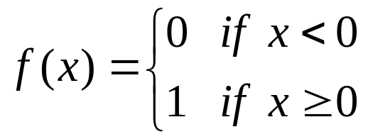
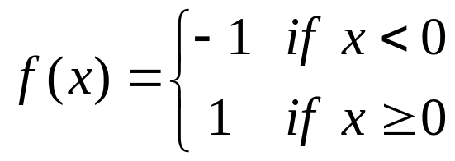
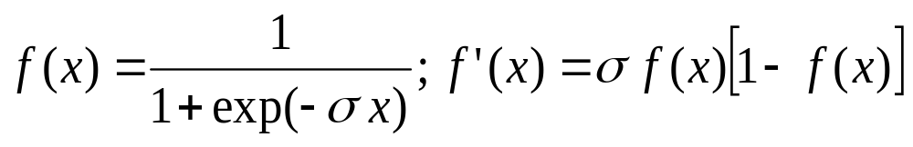
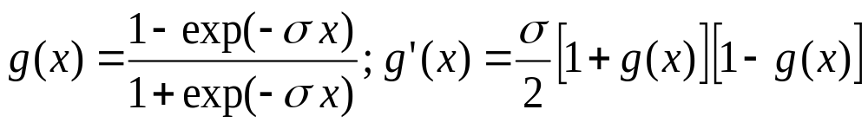
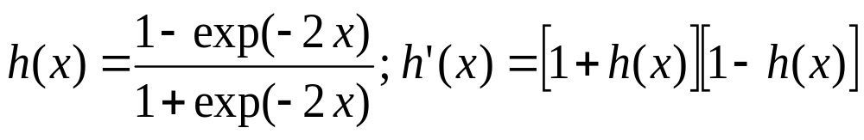
Common Activation Functions
1. Binary Step Function
(a “threshold” or “Heaviside” function)
2. Bipolar Step Function
3. Binary Sigmoid Function
(Logistic Sigmoid)
3. Bipolar Sigmoid
4. Hyperbolic -
Tangent

Slide 43
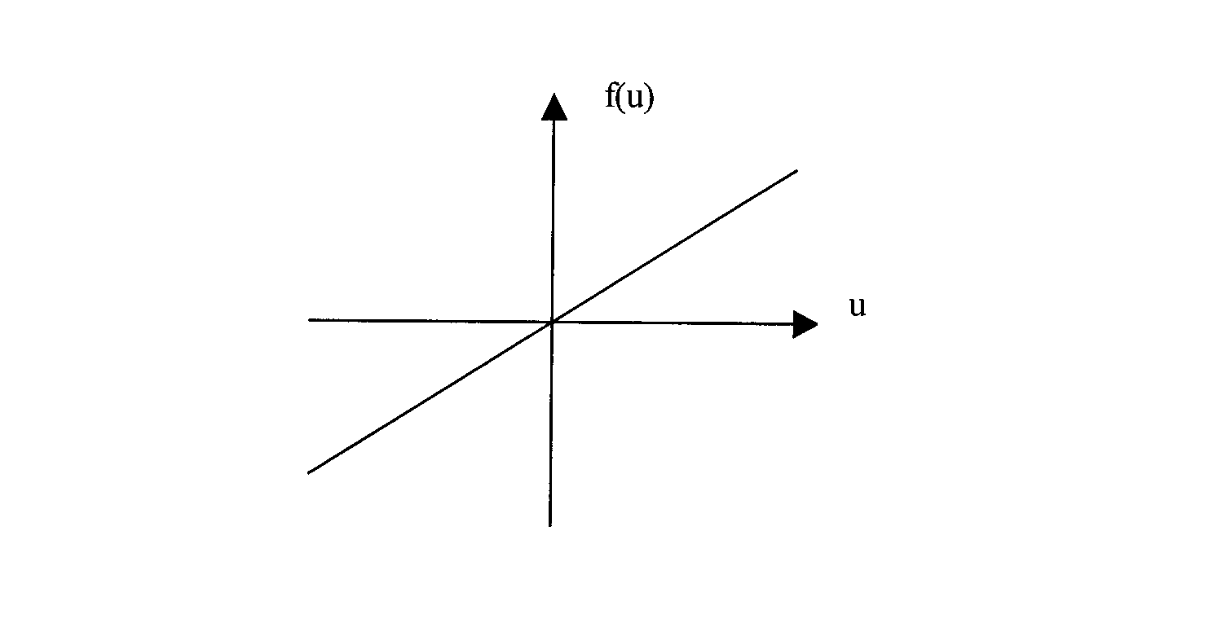

NEURAL NETWORKS
Multi Layer Perceptron: Activation functions

Slide 44

NEURAL NETWORKS
Multi Layer Perceptron: Activation functions

Slide 45
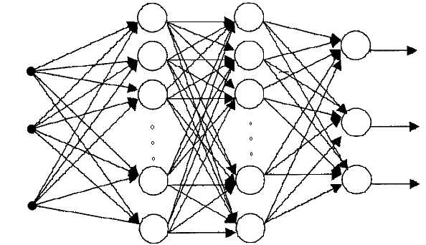
NEURAL NETWORKS
Multi Layer Perceptron: Architecture & Forward Pass
Input Units Hidden Units Output Units

Slide 46
NEURAL NETWORKS
Backpropagation Algorithm
Set up the architecture & initialize the weights of the network
Apply the training pairs (input-output vectors) from the training set, one by one
For each training pair, calculate the output of the network
Calculate the error between actual output & desired output
Propagate the error backwards & adjust the weights in such a way that minimizes the error
Repeat the above steps for each pair in the training set until the error for the set is lower than the required minimum error

Slide 47
NEURAL NETWORKS
Multi Layer Perceptron:
Training by Backpropagation Algorithm
Let E = accumulative error over a data set. It is a function of network weights
E = ∑_{training samples}∑_{j} (d_{j} – O_{j})²
d_{j} is the desired output of node j and O_{j} is the actual output
The error is squared so that the positive and negative errors may not cancel each other out during summation

Slide 48
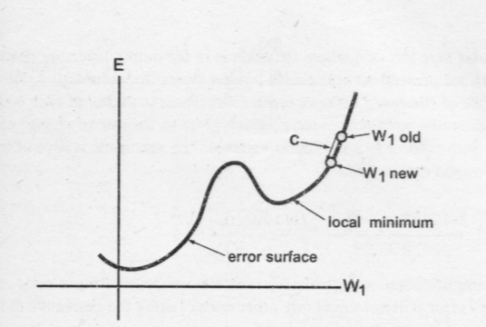
NEURAL NETWORKS
Multi Layer Perceptron:
Training by Backpropagation Algorithm
Each weight configuration can be represented by a point on an error surface

Slide 49
NEURAL NETWORKS
Multi Layer Perceptron: Training
Starting from a random weight configuration, we want our training algorithm to move in the direction where error is reduced more rapidly
Delta rule attempts to minimize the local error and uses the derivative of the error to find the slope of the error space in the region local to a particular point

Slide 50
NEURAL NETWORKS
Multi Layer Perceptron: Training
Delta rule uses gradient descent:
Δw_{ij} = -c (∂Error/ ∂w_{ij})
Let current weight be 4
Then ∂Error/ ∂w_{ij} = 9.5 – 9.0/5 – 3 = 0.25
The new weight will be w_{new} = w_{old} –c*0.25 = 3.875
if c = 0.5 (c is the learning rate)
If the error curve had been downward, then
∂Error/ ∂w_{ij} = 9.0 – 9.5/5 – 3 = -0.25
The new weight will be
w_{new} = w_{old} –c*-0.25 = 4.125

Slide 51
NEURAL NETWORKS
Multi Layer Perceptron: Training
Delta rule:
Δw_{ij} = -c (∂Error/ ∂w_{ij})
If the learning constant “c” is large (more than 0.5), weights move quickly to optimal value but there is a risk of overshooting the minimum or oscillation around optimum weights
If “c” is small, the training is less prone to these problems but system does not learn quickly; also the algorithm may get stuck in local minima

Slide 52
NEURAL NETWORKS
Multi Layer Perceptron: Training
The weights are updated incrementally, following the presentation of each training example
This corresponds to a stochastic approximation to gradient descent
To obtain the true gradient of Error, one would consider all of the training examples before altering the weight values
The stochastic approximation avoids costly computations per weight update

Slide 53
NEURAL NETWORKS
Multi Layer Perceptron: Training of Output Layer Weights
Randomly set the weights
Present first training input vector to the network
Calculate the outputs of all neurons
The inputs to the last layer of neurons would be the output of 2nd last layer
We calculate the Error of all the output neurons and now we wish to change the weights of an output neuron “j” so that its error reduces
We use Delta rule:
Δw_{ij} = -c (∂Error/ ∂w_{ij})

Slide 54
NEURAL NETWORKS
Multi Layer Perceptron: Training of Output Layer Weights
The equation ∂Error/ ∂w_{ij} means that we want the rate of change of network error as a function of the change in one of weights of an output node j
Since for our current training sample
Error = ∑_{j} (d_{j} - O_{j})²
Where O_{j} is itself a function of other variables (including w_{ij}), therefore we use partial derivatives (they gives us the rate of change of a multi-variable function w.r.t a particular variable)

Slide 55
NEURAL NETWORKS
Multi Layer Perceptron: Training of Output Layer Weights
To calculate this quantity we use chain rule
The Error is only indirectly dependent on w_{ij}, but it is directly dependent on variable O_{j}
∂Error/ ∂w_{ij} = (∂Error/ ∂O_{j}) . (∂ O_{j} / ∂w_{ij})
∂Error/ ∂O_{j} = rate of change of error w.r.t output of node j
Now ∂Error/ ∂O_{j} = ∑_{j} (d_{j} - O_{j})² /∂O_{j} = -2(d_{j} - O_{j})
For ∂ O_{j} / ∂w_{ij} we have (∂ O_{j} / ∂act_{j}) (∂ act_{j} / ∂w_{ij})
(∂ O_{j} / ∂act_{j}) = (∂ f(act)_{j} / ∂act_{j}) = f’(act_{j})
(∂ act_{j} / ∂w_{ij}) = (∂ ∑_{i} x_{i}w_{ij}/ ∂w_{ij}) = x_{i}
Hence Δw_{ij} = -c (∂Error/ ∂w_{ij}) = -c[-(d_{j} - O_{j}) . f’(act_{j}) . x_{i}]

Slide 56
NEURAL NETWORKS
Multi Layer Perceptron: Training of Hidden Layer Weights
The formula for hidden layer weights update is different
because
the training examples provide target values only for the network outputs, and no target values are directly available to indicate the error of hidden unit’s values

Slide 57
NEURAL NETWORKS
Multi Layer Perceptron: Training of Hidden Layer Weights
j
w_{ki}
k
i
Hidden layer
Output layer

Slide 58
NEURAL NETWORKS
Multi Layer Perceptron: Training of Hidden Layer Weights
Adjustment of k^{th} weight of node “i”
Δw_{ki} = -c (∂Error/ ∂w_{ki})
Since Error is not a direct function of weight w_{ki}, therefore we use chain rule
∂Error/ ∂w_{ki} = (∂Error/ ∂O_{i}) . (∂ O_{i} / ∂w_{ki})
∂Error/ ∂O_{i} = rate of change of error w.r.t output of node i
= ∂ ∑_{j} Error_{j}/ ∂O_{i}
k
w_{ki}
i

Slide 59
NEURAL NETWORKS
Multi Layer Perceptron: Training of Hidden Layer Weights
Since each Error_{j} is independent
of other Error_{j}
(each has its own independent weight set)
Hence
∂ ∑_{j} Error_{j}/ ∂O_{i} = ∑_{j} (∂ Error_{j}/ ∂O_{i} )
Again use chain rule we have
= ∑_{j} [(∂ Error_{j}/ ∂act_{j}) . (∂act_{j} / ∂O_{i})]
k
w_{ki}
i

Slide 60
NEURAL NETWORKS
Multi Layer Perceptron: Training of Hidden Layer Weights
∂ ∑_{j} Error_{j}/ ∂O_{i} = ∑_{j} [(∂ Error_{j}/ ∂act_{j}) . (∂act_{j} / ∂O_{i})]
∂ Error_{j}/ ∂act_{j} = (∂ Error_{j}/ ∂O_{j}) (∂ O_{j}/ ∂act_{j})
where ∂ Error_{j}/ ∂O_{j} = ∂ (d_{j} – O_{j})²/ ∂O_{j} = -2(d_{j} - O_{j})
and ∂ O_{j}/ ∂act_{j} = ∂ f(act_{j})/ ∂act_{j} = f’(act_{j})
(∂act_{j} / ∂O_{i}) = (∂ ∑ x_{i}w_{ij} / ∂O_{i})
Since O_{i} = x_{i}
hence ∂act_{j} / ∂O_{i} = w_{ij}

Slide 61
NEURAL NETWORKS
Multi Layer Perceptron: Training of Hidden Layer Weights
So we started with
∂Error/ ∂w_{ki} = (∂Error/ ∂O_{i}) . (∂ O_{i} / ∂w_{ki})
and we have determined the first part
For the 2nd part
∂ O_{i} / ∂w_{ki} = (∂ O_{i} / ∂act_{i})(∂ act_{i} / ∂w_{ki})
(∂ act_{i} / ∂w_{ki}) = (∂ ∑_{k} x_{k}w_{ki}/ ∂w_{ki}) = x_{k}
(∂ O_{i} / ∂act_{i}) = (∂ f(act)_{i} / ∂act_{i}) = f’(act)_{i}
Hence Δw_{ki} = -c (∂Error/ ∂w_{ki})
= -c[-2∑_{j} {(d_{j} - O_{j}) f’(act_{j}) w_{ij} }f’(act)_{i} x_{k}]
k
w_{ki}
i

Slide 62
NEURAL NETWORKS
Multi Layer Perceptron: Training
A typical activation function is logistic function (which is a type of sigmoidal function)
f(act) = 1/(1 + e^{-λact})
If value of λ (squashing parameter) is large we have a unit step function, if it is small we have almost a straight line between two saturation limits
f’(act) = f(act)(1 – f(act))

Slide 63
NEURAL NETWORKS
Multi Layer Perceptron: Training
This approach is called “gradient descent learning”
Requirement of this approach is that the activation function must be differentiable (i.e. continuous)
The number of input and output neurons are fixed
But the selection of number of hidden layers and the number of neurons in the hidden layers is done by trial and error

Slide 64
NEURAL NETWORKS
Multi Layer Perceptron: Training
The gradient descent is not guaranteed to converge to the global optimum
The algorithm we have discussed is the incremental gradient descent (or stochastic gradient descent) version of the Backpropagation

Slide 65
Δw_{ij} = -c (∂Error/ ∂w_{ij}) = -c[-(d_{j} - O_{j}) . f’(act_{j}) . x_{i}]
Δw_{ki} = -c (∂Error/ ∂w_{ki})
= -c[-2∑_{j} {(d_{j} - O_{j}) f’(act_{j}) w_{ij} }f’(act)_{i} x_{k}]

Slide 66
NEURAL NETWORKS
Multi Layer Perceptron: Face Recognition Example
Images of 20 different people
32 images per person
With varying expressions (happy, sad, angry, neutral)
and
looking in various directions (left, right, straight, up)
and
with and without sunglasses
Grayscale images (intensity between 0 to 255) and
size (resolution) of 120 x 128 pixels

Slide 67
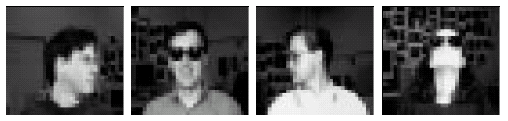

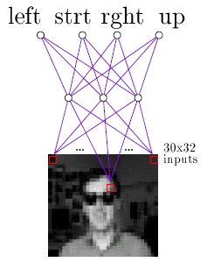
NEURAL NETWORKS
Multi Layer Perceptron: Face Recognition Example

Slide 68
NEURAL NETWORKS
Multi Layer Perceptron: Face Recognition Example
An ANN can be trained on any one of a variety of target functions using this image data, e.g.
- identity of a person
- direction in which person is looking
- whether or not they are wearing sunglasses

Slide 69
NEURAL NETWORKS
Multi Layer Perceptron: Face Recognition Example
Design Choices:
Separate the data into
training (260 images) and test sets (364 images)
Input Encoding
- 30 x 32 pixel image
- A coarse resolution of the 120 x 128 pixel image
- Every 4 x 4 pixels are replaced by their mean value
- The pixel intensity is linearly scaled from 0 to 1 so that inputs, hidden units and output units have the same range

Slide 70
NEURAL NETWORKS
Multi Layer Perceptron: Face Recognition Example
Design Choices:
Output Encoding
- Learning Task: Direction in which person is looking
- Only one neuron could have been used with outputs
0.2, 0.4, 0.6, and 0.8 to encode the four possible values
- But we use 4 output neurons, so that measure of confidence in the ANN’s decision can be obtained
- Output vector:
1 for true & 0 for false; e.g. [1, 0, 0, 0]

Slide 71
NEURAL NETWORKS
Multi Layer Perceptron: Face Recognition Example
Design Choices:
Network Structure
- How many Layers?
Usually one hidden layer is enough
- How many units in the hidden layer
More than necessary units result in over-fitting
Less units result in failure of training
Trial & error: Start with a number and prune the units with the help of a cross-validation set

Slide 72
Reading Assignment & References
1. Section 10.1.1, 10.2.1 and 10.2.2
from George F. Luger
2. Machine Learning by Tom Mitchell
http://www-2.cs.cmu.edu/afs/cs/project/ai-repository/
ai/areas/neural/systems/nevprop/np.c

